Slide 1
COMPUTER NETWORKING
BHAVANA
DAY 2
02/04/2024

Slide 2
Communications
Data communication-examines how data, in the form of energy, travel across some medium from a source to a destination.
A Brief History about Communications
1837- Samuel Morse invented the telegraph.
Coding is done with the Morse code
1876- Alex. Graham Bell invented the telephone. Voice is converted into electrical energy and transmitted over a wire.
1945- ENIAC was invented as the first electronic computer
1980s-Personal Computers become a new way of computing
1990s-came the emergence of the Internet and World Wide Web applications

Slide 3
Transmitted via Communication Media
Voice - encoded signals
Video - encoded images
Data - character streams
Communication Applications
Voice - telephone, FAX, Video Conferencing, Cellular phones, etc.
Video & Audio - television, VCR, DVD, etc.
Data - LAN, WAN, Internet, etc.

Slide 4
Networking
• Networking-computers communicate with each other via networks. Computer network-a communication system for connecting computers using a single transmission technology.
Network Topology
Bus topology
Star topology
Ring topology
Fully connected topology
Combined topology

Slide 5
Protocols
All parties involved in a communication must agree in a set of rules to be used when exchanging messages. Thus, the set of rules which both the sender and the receiver all comply with is called protocol.
A protocol specifies the message format, meanings, and the procedures is known as a communication protocol.
Key Elements of a Protocol
Syntax
Data formats
Signal levels
Semantics
Control information
Error handling
Timing
Speed matching
Sequencing

Slide 6
Communication Reference Models
We need a communication reference model to describe the relationship between various software and hardware.
A reference model describes the layering relationship of software and hardware involved in the communication.
A Communications Model
Source
- generates data to be transmitted
Transmitter
- Converts data into transmittable signals
Transmission System
- Carries data
Receiver
-Converts received signal into data
Destination
- Takes incoming data

Slide 7
Protocol Architecture
Task of communication broken up into modules
For example file transfer could use three modules
File transfer application
Communication service module
Network access module
Protocol Data Units (PDU)
At each layer, protocols are used to communicate
Control information is added to user data at each layer
Transport layer may fragment user data
Each fragment has a transport header added
Destination SAP
Sequence number
Error detection code
This gives a transport protocol data unit

Slide 8
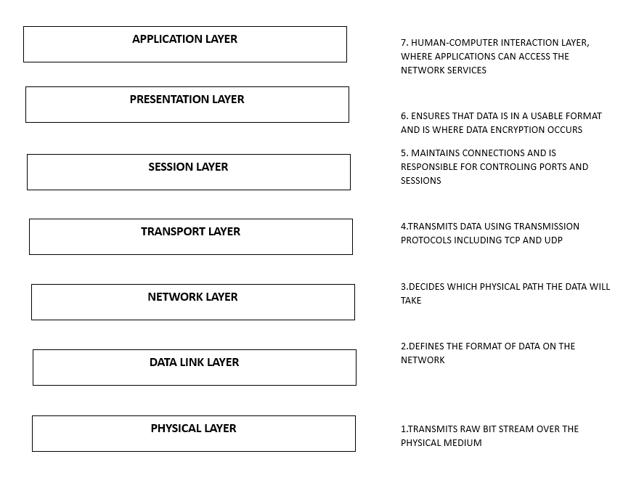
OSI LAYERS

Slide 9
TCP/IP
TCP/IP stands for Transmission Control Protocol/Internet Protocol and is actually a set of standards that describe how data is to be transferred between computers.
TCP/IP is the common tongue that all computers must speak to communicate via Internet.
There are implementations for UNIX, Windows, Macintosh, and just about any computer operating systems you can think of. TCP/IP is implemented as part of an Operating System.

Slide 10
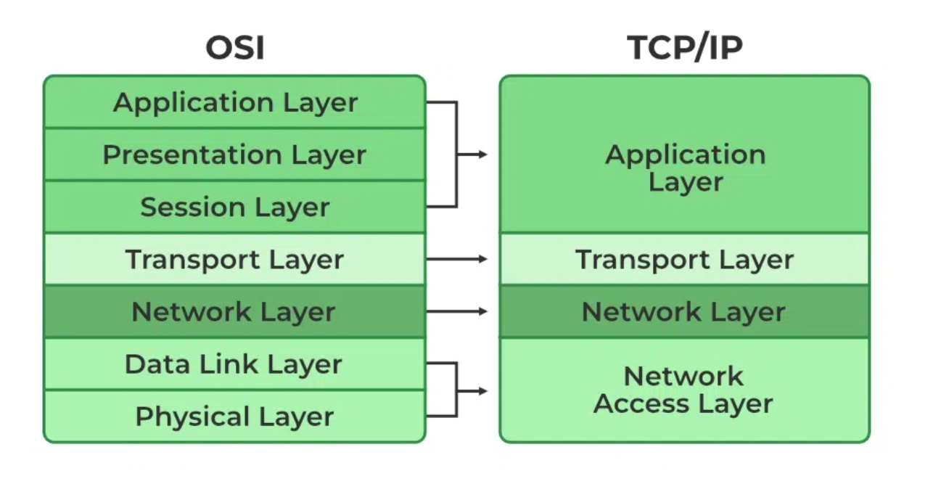
TCP/IP Protocol Architecture
Application layer
Transport layer: host-to-host (application to application)
Internet layer: network routing and congestion control
Network access layer: Access transmission medium
Physical layer

Slide 11
Network
There are many types of networks
* Transportation Networks
◇ Transport goods using trucks, ships, airplanes, ...
Postal Services
* Delivering letters, parcels, etc.
→ Broadcast and cable TV networks
❖ Telephone networks
❖ Internet
* "Social/Human networks"

Slide 12
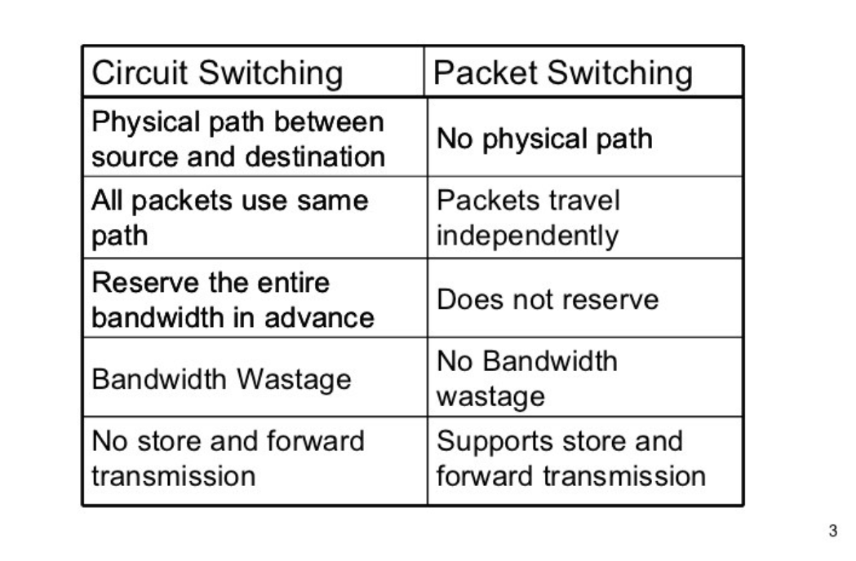
Resource Sharing in Switched Networks
Circuit Switching
set up a dedicated route ("circuit") first
carry all bits of a "conversation" on one circuit
original telephone network
Analogy: railroads and trains
Packet Switching
divide information into small chunks ("packets")
each packet delivered independently
"store-and-forward" packets

Slide 13
Fundamental Issues in Networking
• Naming/Addressing
How to find name/address of the party (or parties) you would like to communicate with
Address: bit- or byte-string that identifies a node Types of addresses
Unicast: node-specific
Broadcast: all nodes in the network
Multicast: some subset of nodes in the network
•Routing/Forwarding:
process of determining how to send packets towards the destination based on its address
Finding out neighbors, building routing tables

Slide 14
Bit-level errors: due to electrical interferences
Packet-level errors: packet loss due to buffer
overflow/congestion
Out of order delivery: packets may takes different paths
Link/node failures: cable is cut or system crash
Detecting whether there is an error!
Fixing the error if possible
Deciding how fast to send, meeting user demands, and managing network resources efficiently
Make sure integrity and authenticity of messages,

Slide 15
IP Address
An IP address is a unique global address for a network interface
Exceptions:
An IP address:
- is a 32 bit long identifier encodes a network number (network prefix) and a host number
Why IP addresses?
A MAC address has no structure, so it tells a switch the identity (who) of the destination interface but not its location (where).
With just MAC addresses, switches would have to resort to broadcast the first time they encounter a new address.

Slide 16
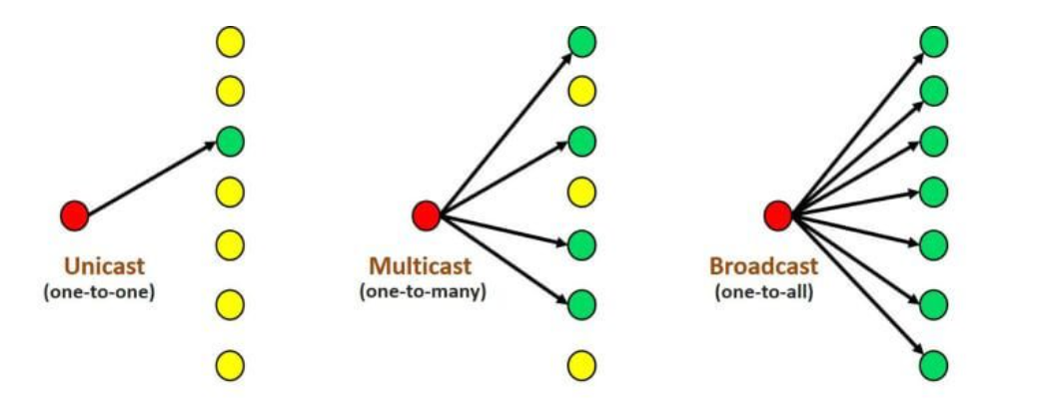
Unicast means one-to-one, data send to only one device means sender sends data to only one device.
Multicast means one-to-many (or many-to-many), data sent to multiple devices means sender sends data to many devices (not all devices like the broadcast).
Broadcast means one-to-all, data sent to all devices means sender sends data to all devices

Slide 17
What is a subnet?
A subnet, or subnetwork, is a network inside a network. Subnets make networks more efficient. Through subnetting, network traffic can travel a shorter distance without passing through unnecessary routers to reach its destination.
Advantages of Subnetting
With subnetting, IP addresses use a 3-layer hierarchy:
>> Network
>> Subnet
>> Host
Reduces router complexity. Since external routers do not know about subnetting, the complexity of routing tables at external routers is reduced.

Slide 18
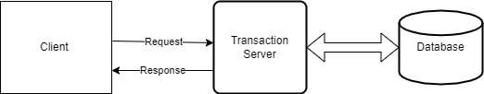
What is DNS?
The Domain Name System (DNS) is the phonebook of the Internet. Humans access information online through domain names, like nytimes.com or espn.com. Web browsers interact through Internet Protocol (IP) addresses. DNS translates domain names to IP addresses so browsers can load Internet resources.
CLIENT-SERVER TRANSACTION:

